Slide 1
Class 3 - React essentials
part 2
Tic-tac-toe game
Tic-tac-toe_step_0_empty

Slide 2
Index.jsx
import ReactDOM from 'react-dom/client';
import App from './App.jsx';
import './index.css';
ReactDOM.createRoot(document.getElementById('root')).render(<App />);

Slide 3
App.jsx
function App() {
return (
<h1>React Tic-Tac-Toe</h1>
)
}
export default App

Slide 4
Player 1 ……………….
Player 2 ……………….
log of previous games

Slide 5
App.jsx
function App() {
return (
<main>
<div id="game-container">
<ol id=”players”>
PLAYERS
</ol>
GAME BOARD
</div>
LOG
</main>
)
}
export default App

Slide 6
Let us add basic information to App.jsx
function App() {
return (
<main>
<div id="game-container">
<ol id="players">
<li>
<span className="player">
<span className='player-name'>Player 1</span>
<span className='player-symbol'>X</span>
</span>
<button>Edit</button>
</li>
<li>
<span className="player">
<span className='player-name'>Player 2</span>
<span className='player-symbol'>O</span>
</span>
<button>Edit</button>
</li>
</ol>
GAME BOARD
</div>
LOG
</main>
)
}
export default App
As You can see, we repeat several lines of code twice. It is a very good signal that we should make a module out of it. Let us name it Player.jsx. Create the file, move contents into this file, adjust the code in App.jsx, in case of problems use Tic-Tack-Toe_step_1

Slide 7
App.jsx
import Player from './Player';
function App() {
return (
<main>
<div id="game-container">
<ol id="players">
<Player name="MissW" symbol="X" ></Player>
<Player name="MisterQ" symbol = "O"></Player>
</ol>
GAME BOARD
</div>
LOG
</main>
)
}
export default App

Slide 8
Player.jsx
export default function Player({name, symbol}){
return(
<>
<li>
<span className="player">
<span className='player-name'>{name}</span>
<span className='player-symbol'>{symbol}</span>
</span>
<button>Edit</button>
</li>
</>
);
}

Slide 9
Next step - task
Now we need the Edit button which should change into Save if we press it
We already know that for that we need a state function
so add to Player.jsx component useState
import {useState} from ’react’;
const [isEditing, setIsEditing]=UseState(false);
build up on this state and make sure that this buton triggers the function which sets the variable isEditing to true;
Next show the <span className-”player-name”/> only when isEditing is false
And show on the <input> element (does not have to work) if isEditing is true
You can work either in Your project or open Tic-Tac-Toe_step_1 project
There are more instructions on the next page

Slide 10
Next step – task – instructions continued
You need the second state to save and change the name after editing, so You will use:
const [playerName, setPlayerName] = useState(initialName);
const [isEditing, setIsEditing] = useState(false);
write a function handleEdit (when user clicks „Edit” buton to change name)
write a function handleChange (when user wants to save a new name)
create a variable:
let editablePlayerName = <span className="player-name">{playerName}</span>; which changes if isEditing is true because we want to see the input field to write a new name:
editablePlayerName = <input type="text" required defaultValue={playerName} onChange={handleChange} />
event.target.name is where we would have a new name
Do not go to the next slide until You finished writing the code (the solution is there)

Slide 11
Changing the name of the player – App.js
import Player from './Player';
function App() {
return (
<main>
<div id="game-container">
<ol id="players">
<Player initialName="MissW" symbol="X" ></Player>
<Player initialName="MisterQ" symbol = "O"></Player>
</ol>
GAME BOARD
</div>
LOG
</main>
)
}
export default App

Slide 12
Changing the name of the player – Player.js
import {useState} from 'react';
export default function Player({initialName, symbol}){
const [playerName, setPlayerName] = useState(initialName);
const [isEditing, setIsEditing] = useState(false);
function handleEdit(){
// would work but is deeply not recommended
//because it would be scheduled to be executed
//and not executed immediately
//setIsEditing(!isEditing);
setIsEditing((editing)=>!editing);
}
let editablePlayerName = <span className="player-name">{playerName}</span>;
if(isEditing){
editablePlayerName = <input type="text" required defaultValue={playerName} onChange={handleChange} />
}
function handleChange(event){
setPlayerName(event.target.value);
console.log(event.target.value)
//we will get the pointer to the event
//argument will be given as object
//it has target property and it has value property
}
return(
<>
<li>
<span className="player">
{editablePlayerName}
<span className='player-symbol'>{symbol}</span>
</span>
<button onClick={handleEdit}> {isEditing ? 'Save' : 'Edit' }</button>
</li>
</>
);
}
if You need, open Tic-Tac-Toe_step_2

Slide 13
Revision 10 task
Two-way-binding

Slide 14
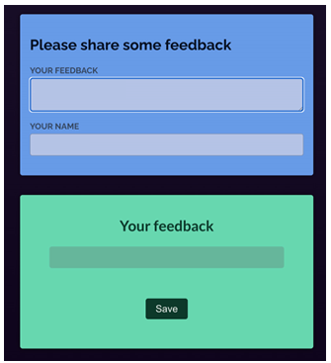
Revision 10 task – 2-way binding
Your task is to collect the values entered into the two input controls (<textarea> and <input>) via two-way binding.
In addition, you should pass the collected values via the appropriate props to the already existing Review component.
The final app should allow users to enter values and then see those entered values in the Review component which is output below the input components. It should look like this (Ignore SAVE buton)

Slide 15
Revision 10 task – 2-way binding – App.jsx
import React from 'react';
// don't change the Component name "App"
function App() {
return (
<>
<section id="feedback">
<h2>Please share some feedback</h2>
<p>
<label>Your Feedback</label>
<textarea />
</p>
<p>
<label>Your Name</label>
<input type="text" />
</p>
</section>
<section id="draft">
<h2>Your feedback</h2>
<Review />
<p>
<button>Save</button>
</p>
</section>
</>
);
}
export default App;

Slide 16
Revision 10 task – 2-way binding – Review.jsx
export default function Review({ feedback, student }) {
return (
<figure>
<blockquote className='feedback'>
<p className='feedback label'>{feedback}</p>
</blockquote>
<figcaption>{student}</figcaption>
</figure>
);
}

Slide 17
Revision 10 task – last instructions
Two-way-binding consists of two key elements:
You must listen to changes to the input (and store the new value somewhere)
You must output the stored value in the input
When updated, the stored input values should cause the App component to be re-evaluated by React
The stored values should also be passed (as props) to the Review component so that they are displayed by that component (take a look at the Review component code in Review.js to see which props are expected)

Slide 18
Review 10 - solution

Slide 19
Revision 10 task – 2-way binding
import Review from './Review.js';
import React from 'react';
import {useState} from 'react';
export default function App() {
const [studentName, setStudentName] = useState('');
const [feedback, setFeedback] = useState('');
function handleChangeName(event) {
setStudentName(event.target.value);
}
function handleChangeFeedback(event) {
setFeedback(event.target.value);
}
return (
<>
<section id="feedback">
<h2>Please share some feedback</h2>
<p>
<label>Your Feedback</label>
<textarea onChange={handleChangeFeedback} value={feedback} />
</p>
<p>
<label>Your Name</label>
<input type="text" onChange={handleChangeName} value={studentName} />
</p>
</section>
<section id="draft">
<h2>Your feedback</h2>
<Review feedback={feedback} student={studentName} />
<p>
<button>Save</button>
</p>
</section>
</>
);
}

Slide 20
Displaying game board
start with Tic-Tac-Toe_step_2
ready solution is in Tic-Tac-Toe_step_3

Slide 21
Rendering multi-dimentional lists – gameboard – App.jsx
const initialGameBoard = [
[null, null, null],
[null, null, null],
[null, null, null]
];
export default function GameBoard(){
return(
<ol id="game-board">
{initialGameBoard.map((row, rowIndex) => (
<li key={rowIndex}>
<ol>
{row.map((playerSymbol, colIndex)=>(
<li key={colIndex}>
<button>{playerSymbol}</button>
</li>
))};
</ol>
</li>
))};
</ol>
);
}

Slide 22
Rendering multi-dimentional lists – gameboard – App.jsx
Now we have to change the state of the board
We should not change the array of arrays directly, because it is not a primitive value, but a reference value
So, it is not a good practice to update the board in this way:
prevGameBoard[rowIndex][colIndex]=’X’;
but instead we should rather do this UPDATE IT IN AN UNMUTABLE WAY:
const updatedBoard = [...prevGameBoard].map(innerArray=>[...innerArray]);
prevGameBoard[rowIndex][colIndex] = 'X';
return prevGameBoard;

Slide 23
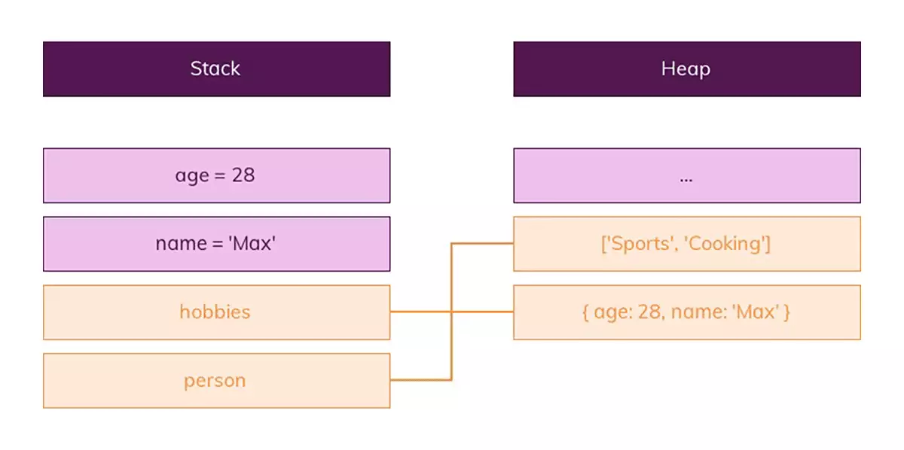
Rendering multi-dimentional lists - gameboard

Slide 24
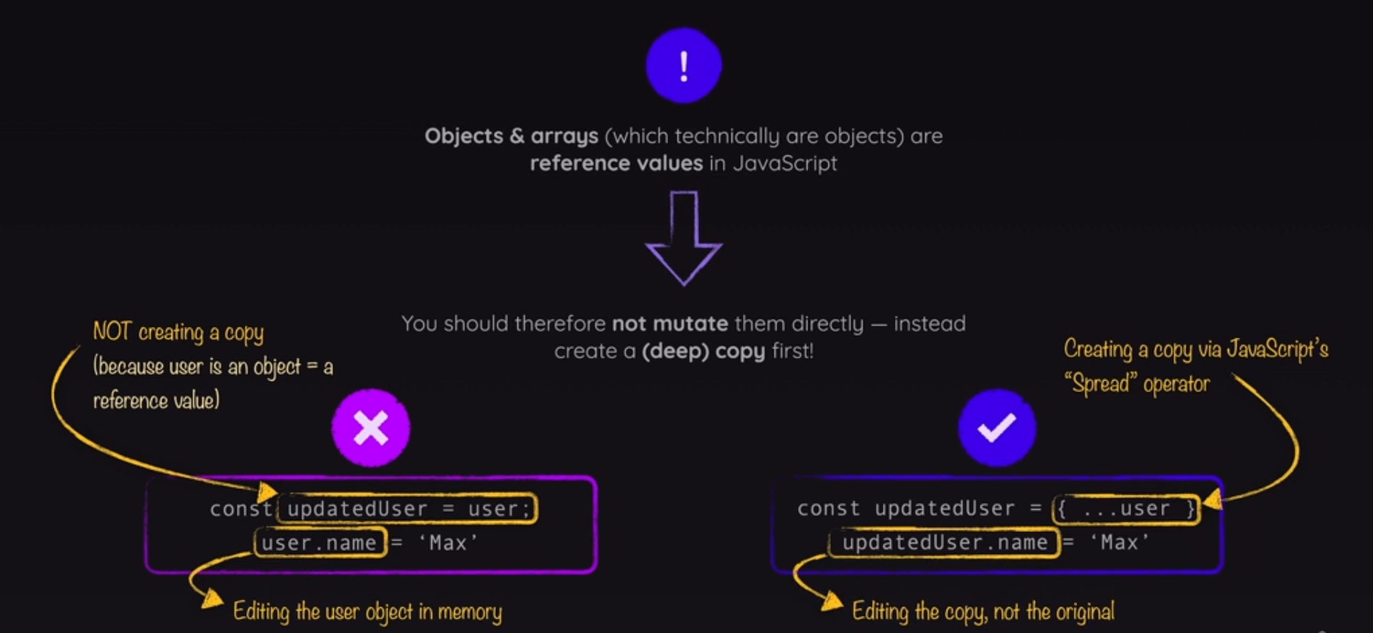
Rendering multi-dimentional lists – gameboard – App.jsx

Slide 25
GameBoard.jsx
Let us create the initial board first:
const initialGameBoard = [
[null, null, null],
[null, null, null],
[null, null, null]
];
And we will create a state function to change the situation on the board:
const [gameBoard, setGameBoard] = useState(initialGameBoard);
Also we need to create a board change - function which will transfer the list of lists into the gameboard
function handleSelectSquare(rowIndex, colIndex){
setGameBoard((prevGameBoard)=>{
const updatedBoard = [...prevGameBoard.map(innerArray=>[...innerArray])];
updatedBoard[rowIndex][colIndex] = 'X';
return updatedBoard;
});
}

Slide 26
GameBoard.jsx – map function explained
We need to map an array of arrays
var array = [[1, 2], [3, 4]];
var double = x => x * 2;
var doubledArray = array.map( subarray => subarray.map( double ));
or:
var doubledArray = array.map( subarray => subarray.map( x=>x*2 ));

Slide 27
GameBoard.jsx – map function expained
array.map(function(currentValue, index, arr), thisValue)
where:
function() – Required, A function to be run for each array element.
currentValue – Required, The value of the current element.
index – Optional, The index of the current element.
arr - Optional, The array of the current element.
thisValue Optional, Default value undefined.
A value passed to the function to be used as its this value.

Slide 28
GameBoard.jsx – map function expained
GameBoard.map(
function(subArray, rowIndex)
{return
subArray.map (
function(symbol, colIndex){return <button>{symbol}<button/>}
}
)

Slide 29
GameBoard.jsx
Now we also need to create the board itself. This is the main purpose of the function GameBoard.
We will use mapping function twice:
firstly, we will map a list of lists onto row and rowIndex
then we will map row onto the colIndex
once we have rowIndex and colIndex, we can set there a button to click
return(
<ol id="game-board">
{gameBoard.map((row, rowIndex) => (
<li key={rowIndex}>
<ol>
{row.map((playerSymbol, colIndex)=>(
<li key={colIndex}>
<button onClick={()=>handleSelectSquare(rowIndex, colIndex)}>{playerSymbol}</button>
</li>
))}
</ol>
</li>
))};
</ol>
);
}

Slide 30
GameBoard.jsx - solution
import {useState} from 'react';
import React from 'react';
const initialGameBoard = [
[null, null, null],
[null, null, null],
[null, null, null]
];
//we do not mutate (change) arrays directly
//they are reference-based objects
//and we change them by making a deep copy
export default function GameBoard(){
const [gameBoard, setGameBoard] = useState(initialGameBoard);
function handleSelectSquare(rowIndex, colIndex){
setGameBoard((prevGameBoard)=>{
const updatedBoard = [...prevGameBoard.map(innerArray=>[...innerArray])];
updatedBoard[rowIndex][colIndex] = 'X';
return updatedBoard;
});
}
let row;
return(
<ol id="game-board">
{gameBoard.map((row, rowIndex) => (
<li key={rowIndex}>
<ol>
{row.map((playerSymbol, colIndex)=>(
<li key={colIndex}>
<button onClick={()=>handleSelectSquare(rowIndex, colIndex)}>{playerSymbol}</button>
</li>
))}
</ol>
</li>
))};
</ol>
);
}

Slide 31
App.jsx - solution
import Player from './Player';
import GameBoard from './GameBoard';
function App() {
return (
<main>
<div id="game-container">
<ol id="players">
<Player initialName="MissW" symbol="X" ></Player>
<Player initialName="MisterQ" symbol = "O"></Player>
</ol>
<GameBoard></GameBoard>
</div>
LOG
</main>
)
}
export default App

Slide 32
Core Concept

Slide 33
Firstly, the styles
We need to know which player is currently active because we want to highlight this player
The problem is that we have two independent instances of players – completely independent
To solve this problem we are going to lift the state up
Instead of determining which player is active either in the gameBoard component or Player component we need to determine this in App.jsx
App.jsx is the closest ancestor component which has access to both components
both: Player and GameBoard need this information
App.jsx can inform both components which player is active through props

Slide 34
Lifting up the state, App.jsx
Firstly, we need to be able to change players in App.jsx, via useState:
const [activePlayer, setActivePlayer] = useState('X’);
and then
function handleSelectedSquare(){
setActivePlayer((curActivePlayer) => curActivePlayer === 'X' ? 'O': 'X');
}
Now we know in App.jsx who is the active player, we recognize them as changes between symbols.
Now we have to pass it to Player and BoardGame components

Slide 35
Lifting up the state, App.jsx
We pass an active player to the Player component
<ol id="players" className="highlight-player">
<Player initialName="MissW" symbol="X" isActive={activePlayer==='X'}></Player>
<Player initialName="MisterQ" symbol = "O" isActive={activePlayer==='O'}></Player>
we also add a css style:
<ol id="players" className="highlight-player">

Slide 36
Lifting up the state, Player.jsx
In the Player component
export default function Player({initialName, symbol, isActive})
and we will add a css style to the <li> wrapper
<li className={isActive ? 'active' : undefined}>

Slide 37
Lifting up the state, GameBoard.jsx
In the Player component
export default function GameBoard({onSelectSquare, activePlayerSymbol})
and we will add a css style to the <li> wrapper
<li className={isActive ? 'active' : undefined}>
Now we update the board with the correct symbol, not just ’X’
updatedBoard[rowIndex][colIndex] = activePlayerSymbol;
<button onClick={()=>handleSelectSquare(rowIndex, colIndex)}>{playerSymbol}</button>
If You had problems, open Tic-Tac-Toe_step_4_styles_and_Core_concept

Slide 38
App.jsx
import Player from './Player';
import GameBoard from './GameBoard';
import './index.css';
import {useState} from 'react';
function App() {
const [activePlayer, setActivePlayer] = useState('X');
function handleSelectedSquare(){
setActivePlayer((curActivePlayer) => curActivePlayer === 'X' ? 'O': 'X');
}
return (
<main>
<div id="game-container">
<ol id="players" className="highlight-player">
<Player initialName="MissW" symbol="X" isActive={activePlayer==='X'}></Player>
<Player initialName="MisterQ" symbol = "O" isActive={activePlayer==='O'}></Player>
</ol>
<GameBoard onSelectSquare={handleSelectedSquare} activePlayerSymbol={activePlayer}></GameBoard>
</div>
LOG
</main>
)
}
export default App

Slide 39
GameBoard.jsx
import {useState} from 'react';
import React from 'react';
const initialGameBoard = [
[null, null, null],
[null, null, null],
[null, null, null]
];
//we do not mutate (change) arrays directly
//they are reference-based objects
//and we change them by making a deep copy
export default function GameBoard({onSelectSquare, activePlayerSymbol}){
const [gameBoard, setGameBoard] = useState(initialGameBoard);
function handleSelectSquare(rowIndex, colIndex){
setGameBoard((prevGameBoard)=>{
const updatedBoard = [...prevGameBoard.map(innerArray=>[...innerArray])];
updatedBoard[rowIndex][colIndex] = activePlayerSymbol;
return updatedBoard;
});
onSelectSquare();
}
let row;
return(
<ol id="game-board">
{gameBoard.map((row, rowIndex) => (
<li key={rowIndex}>
<ol>
{row.map((playerSymbol, colIndex)=>(
<li key={colIndex}>
<button onClick={()=>handleSelectSquare(rowIndex, colIndex)}>{playerSymbol}</button>
</li>
))}
</ol>
</li>
))}
</ol>
);
}

Slide 40
Player.jsx
import {useState} from 'react';
export default function Player({initialName, symbol, isActive}){
const [playerName, setPlayerName] = useState(initialName);
const [isEditing, setIsEditing] = useState(false);
function handleEdit(){
// would work but is deeply not recommended
//because it would be scheduled to be executed
//and not executed immediately
//setIsEditing(!isEditing);
setIsEditing((editing)=>!editing);
}
let editablePlayerName = <span className="player-name">{playerName}</span>;
if(isEditing){
editablePlayerName = <input type="text" required defaultValue={playerName} onChange={handleChange} />
}
function handleChange(event){
setPlayerName(event.target.value);
console.log(event.target.value)
//we will get the pointer to the event
//argument will be given as object
//it has target property and it has value property
}
return(
<>
<li className={isActive ? 'active' : undefined}>
<span className="player">
{editablePlayerName}
<span className='player-symbol'>{symbol}</span>
</span>
<button onClick={handleEdit}> {isEditing ? 'Save' : 'Edit' }</button>
</li>
</>
);
}

Slide 41
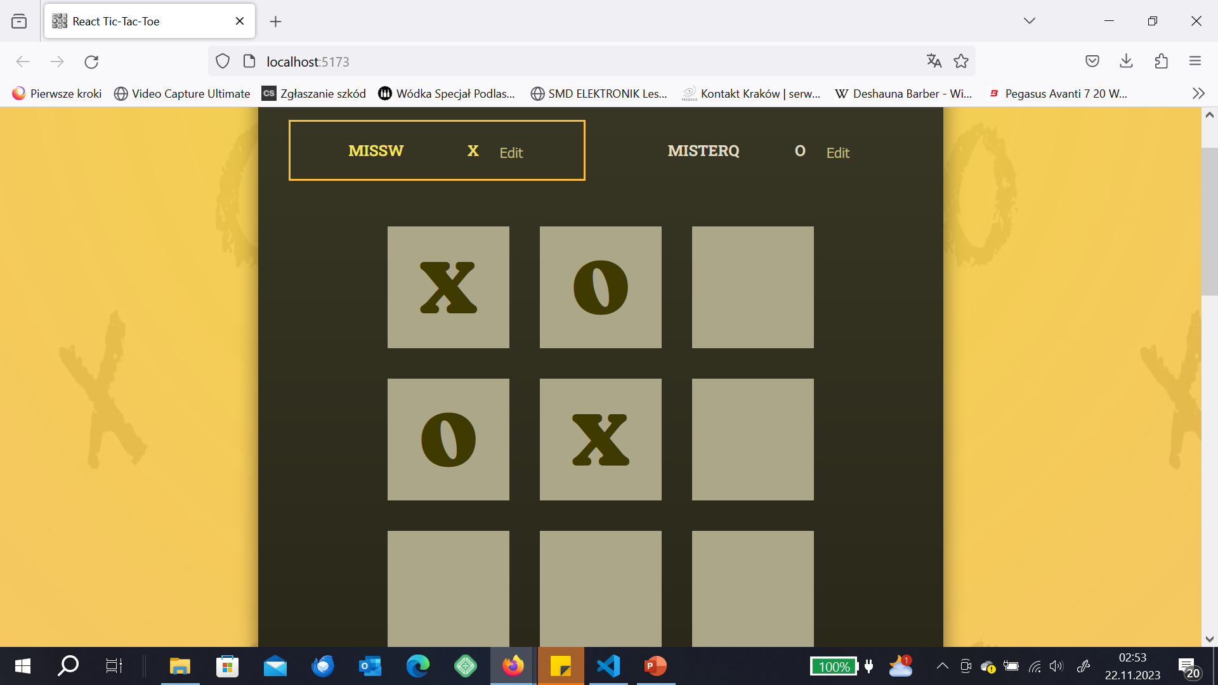

Slide 42
Log component
small remark: backtick symbol ` ` allows to run JS code in React `${sth}`
if You had any problem with a previous contents, open Tic-Tac-Toe_step_4
Ready solution is under Tic-Tac-toe_step_5

Slide 43
Let us create - Log.jsx
export default function Log(){
return(
<ol>
</ol>
);
}
We cannot generate here the information who played it is currently in GameBoard

Slide 44
Log component or lifing state up again, App.jsx
Log component also needs to know which player was active, so again we have to use props to transfer this information to it. As this information was in GameBoard, we will move this proces into App.jsx so each component can see it.
We will adjust App.jsx and remove certain codes from GameBoard

Slide 45
App.jsx
Let us create Log.jsx component,pass an activePlayer as props
import Log.jsx into App.jsx:
import Player from './Player';
import GameBoard from './GameBoard';
import './index.css';
import {useState} from 'react';
import Log from './Log.jsx’
since we have to change players here, let us add a new useState function:
const [gameTurns, setGameTurns] = useState([]);
add <Log/>
and:
function handleSelectedSquare(){
setActivePlayer((curActivePlayer) => curActivePlayer === 'X' ? 'O': 'X');
setGameTurns();
}
The problem is that most of the code which deals with players is inside of GameBoard component and this creates problems now if we want a log

Slide 46
App.jsx
Let us create Log.jsx component,pass an activePlayer as props
import Log.jsx into App.jsx:
import Player from './Player';
import GameBoard from './GameBoard';
import './index.css';
import {useState} from 'react';
import Log from './Log.jsx’

Slide 47
App.jsx
since we have to change players here, let us add a new useState function:
const [gameTurns, setGameTurns] = useState([]);
add <Log/>

Slide 48
App.jsx
Now we also need a hook to change the view of the gameboard
const [gameTurns, setGameTurns] = useState([]);

Slide 49
App.jsx
And let us add:
function handleSelectedSquare(){
setActivePlayer((curActivePlayer) => curActivePlayer === 'X' ? 'O': 'X');
setGameTurns();
}
The problem is that most of the code which deals with players is inside of GameBoard component and this creates problems now if we want a log

Slide 50
App.jsx
import Player from './Player';
import GameBoard from './GameBoard';
import './index.css';
import {useState} from 'react';
import Log from './Log.jsx'
function App() {
const [gameTurns, setGameTurns] = useState([]);
const [activePlayer, setActivePlayer] = useState('X');
function handleSelectedSquare(rowIndex, colIndex){
setActivePlayer((curActivePlayer) => curActivePlayer === 'X' ? 'O': 'X');
setGameTurns(prevTurns => {
let currentPlayer = 'X';
if(prevTurns.length>0 && prevTurns[0].player==='X'){
currentPlayer='O';
}
const updatedTurns = [{square: {row:rowIndex, col:colIndex}, player:currentPlayer},...prevTurns];
return updatedTurns;
});
}
return (
<main>
<div id="game-container">
<ol id="players" className="highlight-player">
<Player initialName="MissW" symbol="X" isActive={activePlayer==='X'}></Player>
<Player initialName="MisterQ" symbol = "O" isActive={activePlayer==='O'}></Player>
</ol>
<GameBoard onSelectSquare={()=>handleSelectedSquare(rowIndex, colIndex)}
turns={gameTurns}>
</GameBoard>
</div>
<Log/>
</main>
)
}
export default App

Slide 51
Log component or lifing state up again, App.jsx
Now we can see that we have to lift up the code which handles the game from GameBoard into App.jsx
we will add turns to store moves and updatedTurns
we will take it from GameBoard and modify so it can work in App.jsx

Slide 52
Lifting up states, App.jsx
We have to make modifications so we have information and code that deals with changing players in App.jsx, instead of GameBoard.jsx
The first step is to add the code to handleSelectedSquare
We need to know which rowIndex and colIndex was used by the player
function handleSelectedSquare(rowIndex, colIndex){
setActivePlayer((curActivePlayer) => curActivePlayer === 'X' ? 'O': 'X');
setGameTurns(prevTurns => {
let currentPlayer = 'X';
if(prevTurns.length>0 && prevTurns[0].player==='X'){
currentPlayer='O';
}
const updatedTurns = [{square: {row:rowIndex, col:colIndex}, player:currentPlayer},...prevTurns];
return updatedTurns;
});
}
We create a list of records (updatedTurns) which remembers which square was selected and which player used it

Slide 53
Lifting up states, App.jsx
import Player from './Player';
import GameBoard from './GameBoard';
import './index.css';
import {useState} from 'react';
import Log from './Log.jsx'
function App() {
const [gameTurns, setGameTurns] = useState([]);
const [activePlayer, setActivePlayer] = useState('X');
function handleSelectedSquare(rowIndex, colIndex){
setActivePlayer((curActivePlayer) => curActivePlayer === 'X' ? 'O': 'X');
setGameTurns(prevTurns => {
let currentPlayer = 'X';
if(prevTurns.length>0 && prevTurns[0].player==='X'){
currentPlayer='O';
}
const updatedTurns = [{square: {row:rowIndex, col:colIndex}, player:currentPlayer},...prevTurns];
return updatedTurns;
});
}
return (
<main>
<div id="game-container">
<ol id="players" className="highlight-player">
<Player initialName="MissW" symbol="X" isActive={activePlayer==='X'}></Player>
<Player initialName="MisterQ" symbol = "O" isActive={activePlayer==='O'}></Player>
</ol>
<GameBoard onSelectSquare={handleSelectedSquare} turns ={GameTurns} activePlayerSymbol={activePlayer}></GameBoard>
</div>
<Log/>
</main>
)
}
export default App

Slide 54
Changes to App.jsx
We remove the code with activePlayerSymbol from GameBoard.jsx
<GameBoard onSelectSquare={handleSelectedSquare}
activePlayerSymbol={activePlayer}>
</GameBoard>
so we will pass a list of turns into GameBoard component, not activePlayer:
<GameBoard onSelectSquare={handleSelectedSquare}
turns={gameTurns}>
</GameBoard>

Slide 55
Player.jsx (no changes)
import {useState} from 'react';
export default function Player({initialName, symbol, isActive}){
const [playerName, setPlayerName] = useState(initialName);
const [isEditing, setIsEditing] = useState(false);
function handleEdit(){
// would work but is deeply not recommended
//because it would be scheduled to be executed
//and not executed immediately
//setIsEditing(!isEditing);
setIsEditing((editing)=>!editing);
}
let editablePlayerName = <span className="player-name">{playerName}</span>;
if(isEditing){
editablePlayerName = <input type="text" required defaultValue={playerName} onChange={handleChange} />
}
function handleChange(event){
setPlayerName(event.target.value);
console.log(event.target.value)
//we will get the pointer to the event
//argument will be given as object
//it has target property and it has value property
}
return(
<>
<li className={isActive ? 'active' : undefined}>
<span className="player">
{editablePlayerName}
<span className='player-symbol'>{symbol}</span>
</span>
<button onClick={handleEdit}> {isEditing ? 'Save' : 'Edit' }</button>
</li>
</>
);
}

Slide 56
Changes to GameBoard.jsx
Since we do not pass an activePlayer anymore, but turns, we have to adjust GameBoard.jsx function
export default function GameBoard({onSelectSquare, activePlayerSymbol})
into:
export default function GameBoard({onSelectSquare, turns})

Slide 57
Changes to GameBoard.jsx
We will remove this function from GameBoard.jsx because we no longer have activePlayer, we have now turns array and we have to read who is the active player from there. So we remove this code:
setGameBoard((prevGameBoard)=>{
const updatedBoard = [...prevGameBoard.map(innerArray=>[...innerArray])];
updatedBoard[rowIndex][colIndex] = activePlayerSymbol;
return updatedBoard;
});
onSelectSquare();
and instead (we are deriving a state from turns array, twice doing restructuring)
function handleSelectSquare(rowIndex, colIndex){
let gameBoard = initialGameBoard;
for (const turn of turns){
const {square, player} = turn;
const {row, col} = square;
gameBoard[row][column] = player;
}

Slide 58
Changes to GameBoard.jsx
We also need to correct the way how we call handleSelectedSquare because a moment ago we changed the code of the function and now it takes 2 arguments:
<button onSelectSquare={()=>onSelectSquare(rowIndex, colIndex)}
turns={gameTurns}>
</button>

Slide 59
GameBoard.jsx (adjusted after moving changing players to App.jsx)
import {useState} from 'react';
import React from 'react';
const initialGameBoard = [
[null, null, null],
[null, null, null],
[null, null, null]
];
export default function GameBoard({onSelectSquare, turns}){
let GameBoard = initialGameBoard;
let gameBoard = initialGameBoard;
for (const turn of turns){
const {square, player} = turn;
const {row, col} = square;
gameBoard[row][col] = player;
}
let row;
return(
<ol id="game-board">
{gameBoard.map((row, rowIndex) => (
<li key={rowIndex}>
<ol>
{row.map((playerSymbol, colIndex)=>(
<li key={colIndex}>
<button onClick={()=>onSelectSquare(rowIndex, colIndex)}>{playerSymbol}</button>
</li>
))}
</ol>
</li>
))}
</ol>
);
}

Slide 60
App.jsx
import Player from './Player';
import GameBoard from './GameBoard';
import './index.css';
import {useState} from 'react';
import Log from './Log.jsx'
function App() {
const [gameTurns, setGameTurns] = useState([]);
const [activePlayer, setActivePlayer] = useState('X');
function handleSelectedSquare(rowIndex, colIndex){
setActivePlayer((curActivePlayer) => curActivePlayer === 'X' ? 'O': 'X');
setGameTurns((prevTurns) => {
let currentPlayer = 'X';
if(prevTurns.length>0 && prevTurns[0].player ==='X'){
currentPlayer='O';
}
const updatedTurns = [{square: {row:rowIndex, col:colIndex}, player:currentPlayer},...prevTurns];
return updatedTurns;
});
}
return (
<main>
<div id="game-container">
<ol id="players" className="highlight-player">
<Player initialName="MissW" symbol="X" isActive={activePlayer==='X'}></Player>
<Player initialName="MisterQ" symbol = "O" isActive={activePlayer==='O'}></Player>
</ol>
<GameBoard onSelectSquare={handleSelectedSquare}
turns={gameTurns}>
</GameBoard>
</div>
<Log/>
</main>
)
}
export default App

Slide 61
Log.jsx (to display moves)
import React from 'react';
export default function Log({turns}){
let i = 1
return(
<ol id="log">
{turns.map((turn) => (<li key={`${turn.square.row}${turn.square.col}`}> {turn.player} selected {`${turn.square.row}, ${turn.square.col}`} </li>))}
</ol>
);
}

Slide 62
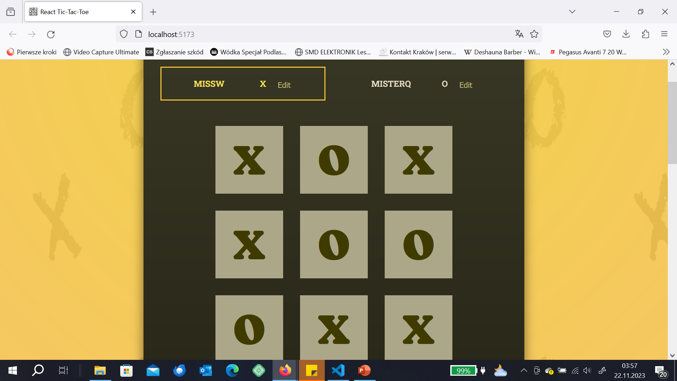

Slide 63
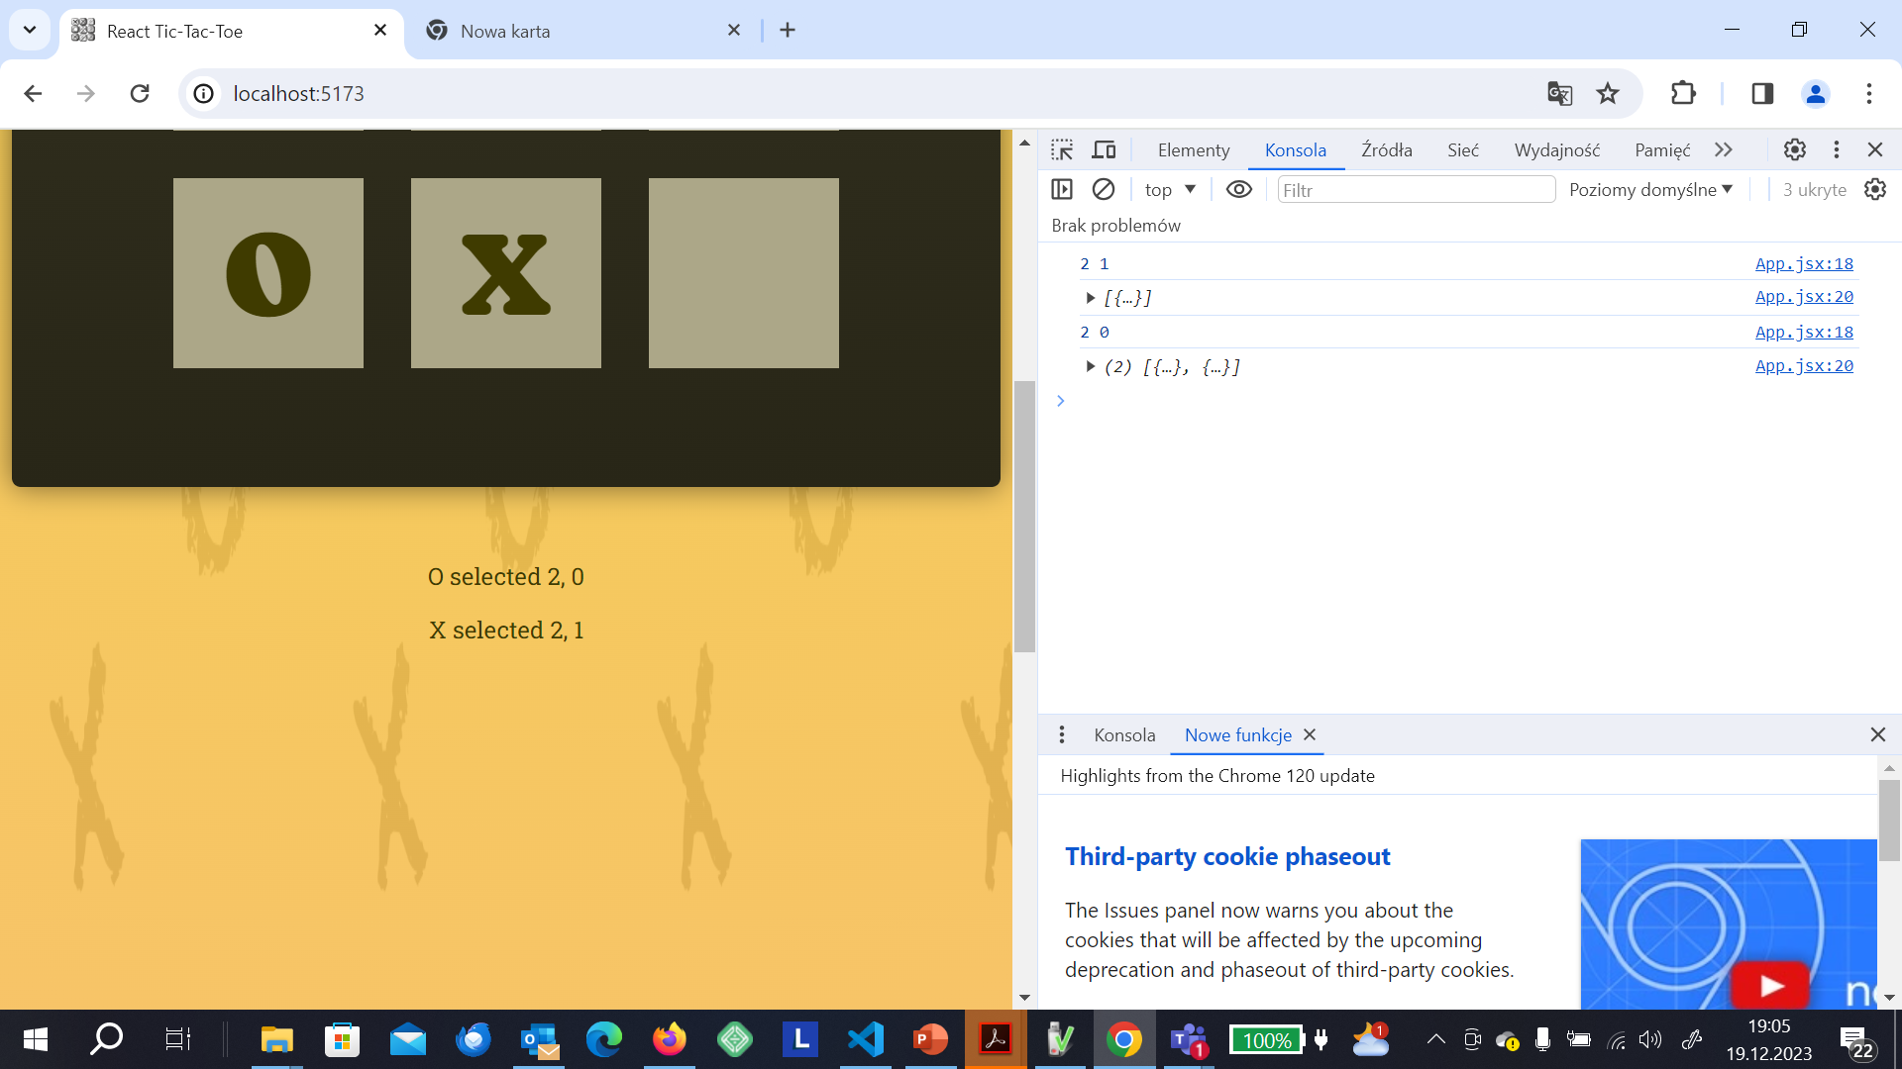

Slide 64
Reducing state management
if You had any problems, open Tic-Tac-Toe_step_6 (before changes we make here)
or Tic-Tac-Toe_step_7 (after the changes)

Slide 65
Reducing state management
We do not need this useState:
const [activePlayer, setActivePlayer] = useState('X’);
setActivePlayer((curActivePlayer) => curActivePlayer === 'X' ? 'O': 'X');
we can get this information from an array turns
we can have a derived state instead

Slide 66
Reducing state management
So we will write a function outside App function which will derive a current Player:
function deriveActivePlayer(gameTurns){
let currentPlayer = 'X';
if(gameTurns.length > 0 && gameTurns[0].player === 'X'){
currentPlayer = 'O';
}
return currentPlayer;
}
and now inside of the function we define activePlayer:
const activePlayer = deriveActivePlayer(gameTurns);

Slide 67
App.jsx
import Player from './Player';
import GameBoard from './GameBoard';
import './index.css';
import {useState} from 'react';
import Log from './Log.jsx'
function deriveActivePlayer(gameTurns){
let currentPlayer = 'X';
if(gameTurns.length > 0 && gameTurns[0].player === 'X'){
currentPlayer = 'O';
}
return currentPlayer;
}
function App() {
let rowIndex;
let colIndex;
const [gameTurns, setGameTurns] = useState([]);
//const [activePlayer, setActivePlayer] = useState('X');
const activePlayer = deriveActivePlayer(gameTurns);
function handleSelectedSquare(rowIndex, colIndex){
// setActivePlayer((curActivePlayer) => curActivePlayer === 'X' ? 'O': 'X');
setGameTurns((prevTurns) => {
const currentPlayer = deriveActivePlayer(prevTurns);
const updatedTurns = [{square: {row:rowIndex, col:colIndex}, player:currentPlayer},...prevTurns];
return updatedTurns;
});
}
return (
<main>
<div id="game-container">
<ol id="players" className="highlight-player">
<Player initialName="MissW" symbol="X" isActive={activePlayer==='X'}></Player>
<Player initialName="MisterQ" symbol = "O" isActive={activePlayer==='O'}></Player>
</ol>
<GameBoard onSelectSquare={handleSelectedSquare}
turns={gameTurns}>
</GameBoard>
</div>
<Log turns={gameTurns} />
</main>
)
}
export default App

Slide 68
Preventing the same blocks being clicked again and winner validation
Open Tic-Tac-Toe_step_7 – before changes
Tic-Tac-Toe_step_8 – after the changes

Slide 69
Blocking used buttons
it is a one-liner
<button onClick={()=>(onSelectSquare(rowIndex, colIndex))} disabled={playerSymbol !== null}>{playerSymbol}</button>

Slide 70
Winning combinations (copy into separate file)
export const WINNING_COMBINATIONS = [
[
{ row: 0, column: 0 },
{ row: 0, column: 1 },
{ row: 0, column: 2 },
],
[
{ row: 1, column: 0 },
{ row: 1, column: 1 },
{ row: 1, column: 2 },
],
[
{ row: 2, column: 0 },
{ row: 2, column: 1 },
{ row: 2, column: 2 },
],
[
{ row: 0, column: 0 },
{ row: 1, column: 0 },
{ row: 2, column: 0 },
],
[
{ row: 0, column: 1 },
{ row: 1, column: 1 },
{ row: 2, column: 1 },
],
[
{ row: 0, column: 2 },
{ row: 1, column: 2 },
{ row: 2, column: 2 },
],
[
{ row: 0, column: 0 },
{ row: 1, column: 1 },
{ row: 2, column: 2 },
],
[
{ row: 0, column: 2 },
{ row: 1, column: 1 },
{ row: 2, column: 0 },
],
];

Slide 71
Checking if someone won (App.jsx)
Now we have to make adjustments in the code so we can easily check whether a move is not the winning move and the game should finisz
For the moment we only care about checking for the winning combination
We have to move the code which is responsible for current players moves and marking tchem in the gameBoard into the App.jsx, otherwise we could not check for the winner
Firstly, import the file with the winning combinations:
import {WINNING_COMBINATIONS} from './WinningCombinations.js’;

Slide 72
Checking if someone won (App.jsx)
So we move the necessary code from gameBoard into App.jsx (before App function):
const initialGameBoard = [
[null, null, null],
[null, null, null],
[null, null, null]
];
function deriveActivePlayer(gameTurns){
let currentPlayer = 'X';
if(gameTurns.length > 0 && gameTurns[0].player === 'X'){
currentPlayer = 'O';
}
return currentPlayer;
}

Slide 73
App.jsx
Now inside of App function we need to call the function which is responsbile for players moves:
const activePlayer = deriveActivePlayer(gameTurns);
and we add checking for winner:
let winner;
for(const combination of WINNING_COMBINATIONS){
const firstSquareSymbol=gameBoard[combination[0].row][combination[0].column];
const secondSquareSymbol=gameBoard[combination[1].row][combination[1].column];
const thisSquareSymbol=gameBoard[combination[2].row][combination[2].column];
if(firstSquareSymbol && firstSquareSymbol===secondSquareSymbol && secondSquareSymbol===thisSquareSymbol){
winner = firstSquareSymbol;
}}

Slide 74
App.jsx and gameBoard.jsx
Now we will pass just a board of the game to gameBoard, not turns:
so in App.jsx:
return (
<main>
<div id="game-container">
<ol id="players" className="highlight-player">
<Player initialName="MissW" symbol="X" isActive={activePlayer==='X'}></Player>
<Player initialName="MisterQ" symbol = "O" isActive={activePlayer==='O'}></Player>
</ol>
{winner && <p>You won! {winner}!</p>}
<GameBoard onSelectSquare={handleSelectedSquare}
board={gameBoard}>
</GameBoard>
</div>
<Log turns={gameTurns} />
</main>
)

Slide 75
App.jsx
import Player from './Player';
import GameBoard from './GameBoard';
import './index.css';
import {useState} from 'react';
import Log from './Log.jsx';
import {WINNING_COMBINATIONS} from './WinningCombinations.js';
const initialGameBoard = [
[null, null, null],
[null, null, null],
[null, null, null]
];
function deriveActivePlayer(gameTurns){
let currentPlayer = 'X';
if(gameTurns.length > 0 && gameTurns[0].player === 'X'){
currentPlayer = 'O';
} return currentPlayer; }
export default function App() {
const [gameTurns, setGameTurns] = useState([]);
const activePlayer = deriveActivePlayer(gameTurns);
let gameBoard = initialGameBoard;
for (const turn of gameTurns){
const {square, player} = turn;
const {row, col} = square;
gameBoard[row][col] = player;
}
let winner;
for(const combination of WINNING_COMBINATIONS){
const firstSquareSymbol=gameBoard[combination[0].row][combination[0].column];
const secondSquareSymbol=gameBoard[combination[1].row][combination[1].column];
const thisSquareSymbol=gameBoard[combination[2].row][combination[2].column];
if(firstSquareSymbol && firstSquareSymbol===secondSquareSymbol && secondSquareSymbol===thisSquareSymbol){
winner = firstSquareSymbol;
}}
function handleSelectedSquare(rowIndex, colIndex){
setGameTurns((prevTurns) => {
const currentPlayer = deriveActivePlayer(prevTurns);
const updatedTurns = [{square: {row:rowIndex, col:colIndex}, player:currentPlayer},...prevTurns];
return updatedTurns;
});
}
return (
<main>
<div id="game-container">
<ol id="players" className="highlight-player">
<Player initialName="MissW" symbol="X" isActive={activePlayer==='X'}></Player>
<Player initialName="MisterQ" symbol = "O" isActive={activePlayer==='O'}></Player>
</ol>
{winner && <p>You won! {winner}!</p>}
<GameBoard onSelectSquare={handleSelectedSquare}
board={gameBoard}>
</GameBoard>
</div>
<Log turns={gameTurns} />
</main>
)
}

Slide 76
gameBoard.jsx
import React from 'react';
export default function GameBoard({onSelectSquare, board}){
let gameBoard = board;
return(
<ol id="game-board">
{gameBoard.map((row, rowIndex) => (
<li key={rowIndex}>
<ol>
{row.map((playerSymbol, colIndex)=>(
<li key={colIndex}>
<button onClick={()=>(onSelectSquare(rowIndex, colIndex))} disabled={playerSymbol !== null}>{playerSymbol}</button>
</li>
))}
</ol>
</li>
))}
</ol>
);
}

Slide 77
Game over screen and checking for draws
Open Tic-Tac-Toe_step_8 – before changes
Tic-Tac-Toe_step_9 – after the changes

Slide 78
GameOver.jsx component
We will not create GameOver.jsx component
it is going to be responsible for:
a nice GameOver message
a buton to re-start the game

Slide 79
GameOver.jsx
export default function GameOver({winner}){
return(
<div id=„game-over”>
<h2>Game Over!</h2>
<p>{winner} won!</p>
<p><button>Rematch!</button></p>
</div>
);
}

Slide 80
App.jsx
We need to import GameOver component and make adjustments with the winner code:
we had:
{winner && <p> {winner} won</p>}
we have:
{winner && <GameOver winner = {winner} />}

Slide 81
Detecting a draw
we have to correct App.jsx code for a draw
we know that we have a draw after 9 game turns
either we have then the winner or a draw after 9 turns
const hasDraw = gameTurns.length === 9 && !winner;
and
{(winner || hasDraw) && <GameOver winner = {winner} />}

Slide 82
GameOver.jsx with draw option
export default function GameOver({winner}){
return(
<div id="game-over">
<h2>Game Over!</h2>
{winner && <p> {winner} won! </p>}
{!winner && <p> It is a draw! </p>}
<p><button>Rematch!</button></p>
</div>
);
}

Slide 83
App.jsx
import Player from './Player';
import GameBoard from './GameBoard';
import './index.css';
import {useState} from 'react';
import Log from './Log.jsx';
import {WINNING_COMBINATIONS} from './WinningCombinations.js';
import GameOver from './GameOver.jsx';
const initialGameBoard = [
[null, null, null],
[null, null, null],
[null, null, null]
];
function deriveActivePlayer(gameTurns){
let currentPlayer = 'X';
if(gameTurns.length > 0 && gameTurns[0].player === 'X'){
currentPlayer = 'O';
}
return currentPlayer;
}
export default function App() {
const [gameTurns, setGameTurns] = useState([]);
const activePlayer = deriveActivePlayer(gameTurns);
let gameBoard = initialGameBoard;
for (const turn of gameTurns){
const {square, player} = turn;
const {row, col} = square;
gameBoard[row][col] = player;
}
let winner;
for(const combination of WINNING_COMBINATIONS){
const firstSquareSymbol=gameBoard[combination[0].row][combination[0].column];
const secondSquareSymbol=gameBoard[combination[1].row][combination[1].column];
const thisSquareSymbol=gameBoard[combination[2].row][combination[2].column];
if(firstSquareSymbol && firstSquareSymbol===secondSquareSymbol && secondSquareSymbol===thisSquareSymbol){
winner = firstSquareSymbol;
}}
let hasDraw = (gameTurns.length === 9 && !winner);
function handleSelectedSquare(rowIndex, colIndex){
// setActivePlayer((curActivePlayer) => curActivePlayer === 'X' ? 'O': 'X');
setGameTurns((prevTurns) => {
const currentPlayer = deriveActivePlayer(prevTurns);
const updatedTurns = [{square: {row:rowIndex, col:colIndex}, player:currentPlayer},...prevTurns];
return updatedTurns;
});
}
return (
<main>
<div id="game-container">
<ol id="players" className="highlight-player">
<Player initialName="MissW" symbol="X" isActive={activePlayer==='X'}></Player>
<Player initialName="MisterQ" symbol = "O" isActive={activePlayer==='O'}></Player>
</ol>
{(winner || hasDraw) && <GameOver winner = {winner} />}
<GameBoard onSelectSquare={handleSelectedSquare}
board={gameBoard}>
</GameBoard>
</div>
<Log turns={gameTurns} />
</main>
)
}

Slide 84
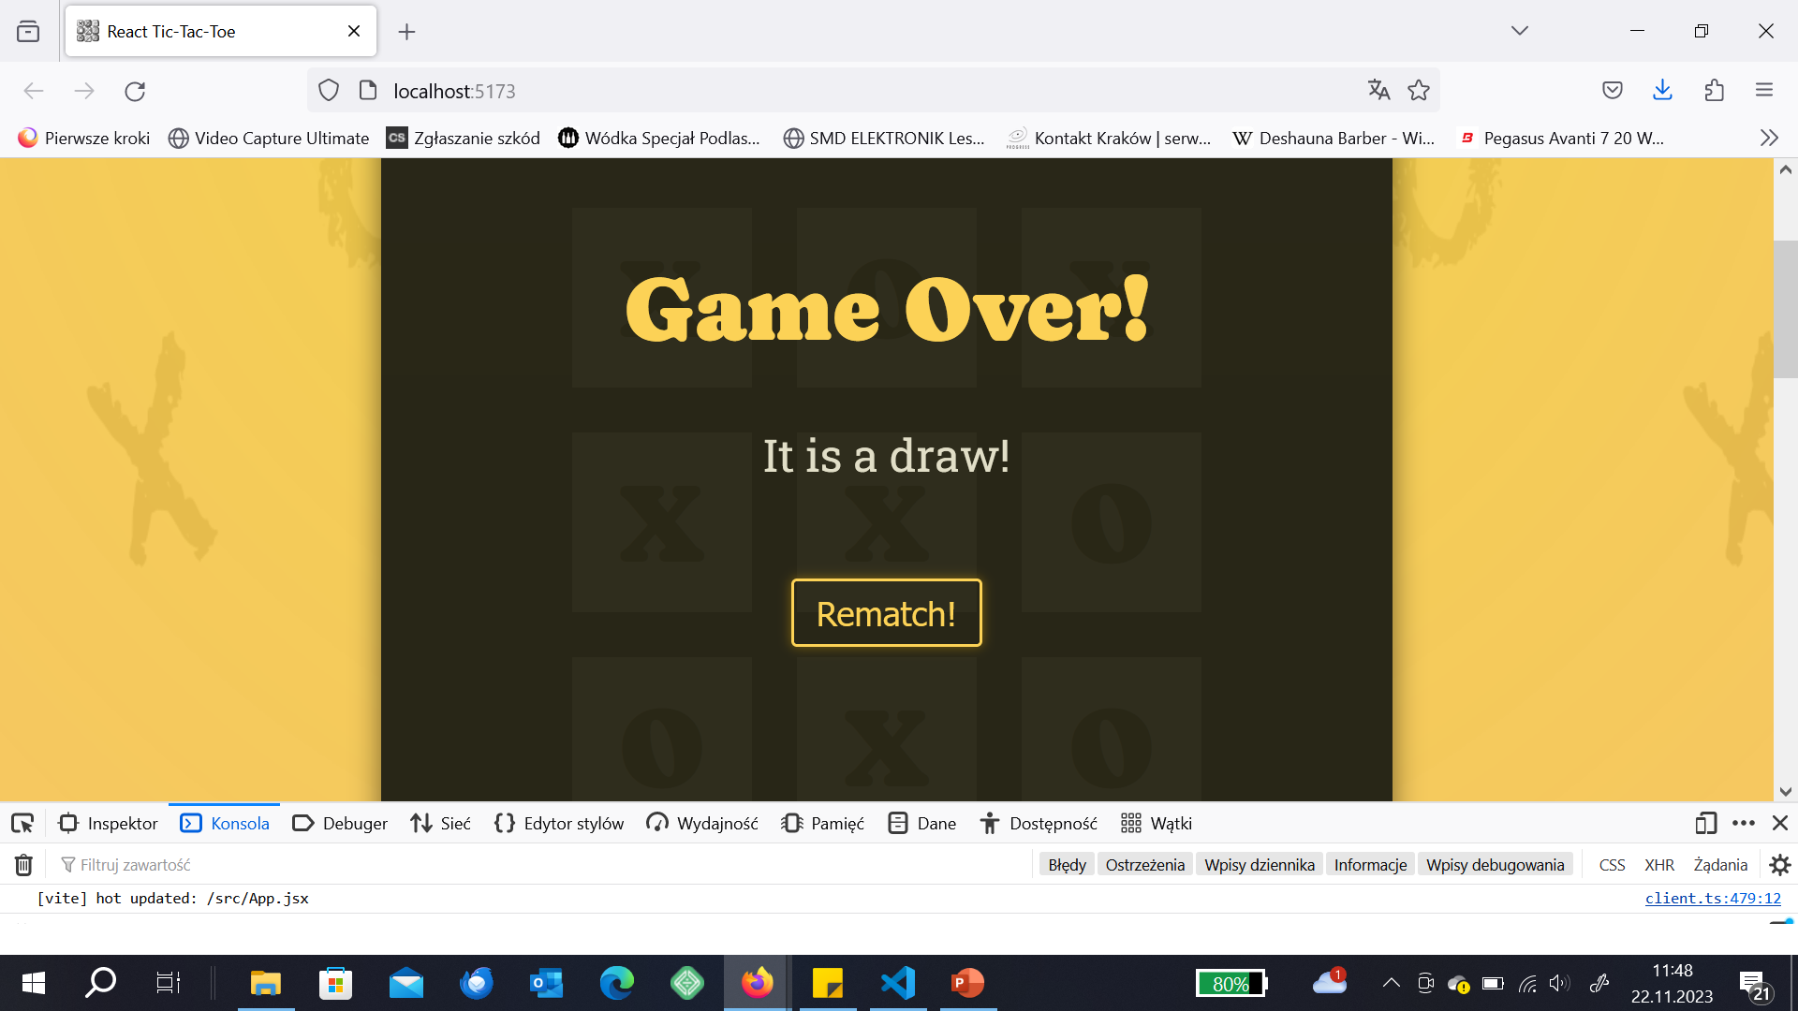

Slide 85
Game restart (clearing the log)
Open Tic-Tac-Toe_step_9 – before changes
Tic-Tac-Toe_step_10 – after the changes

Slide 86
Clearing the log
If the game is re-set we have to clear the log
in App.jsx we just need to set game turns into []
so just before return statement we simply write:
function handleRestart(){
setGameTurns([]);
}
and..
{(winner || hasDraw) && <GameOver winner = {winner} onRestart={handleRestart} />}
Obviously, now we have to adjust GameOver component

Slide 87
Clearing the log
export default function GameOver({winner, onRestart}){
return(
<div id="game-over">
<h2>Game Over!</h2>
{winner && <p> {winner} won! </p>}
{!winner && <p> It is a draw! </p>}
<p><button onClick={onRestart}>Rematch!</button></p>
</div>
);
}

Slide 88
App.jsx – deep copy of a gameBoard
since we now want to clear the gameBoard and since we set user symbols in this way: gameBoard[row][column] = player
we have to make a deep copy of a gameBoard if we want to re-set the game, otherwise despite attempts to set it to [] we will still have previous game symbols
let gameBoard = [...initialGameBoard].map(array=>[...array]);

Slide 89
App.jsx
import Player from './Player';
import GameBoard from './GameBoard';
import './index.css';
import {useState} from 'react';
import Log from './Log.jsx';
import {WINNING_COMBINATIONS} from './WinningCombinations.js';
import GameOver from './GameOver.jsx';
const initialGameBoard = [
[null, null, null], [null, null, null], [null, null, null]
];
function deriveActivePlayer(gameTurns){
let currentPlayer = 'X';
if(gameTurns.length > 0 && gameTurns[0].player === 'X'){
currentPlayer = 'O';
}
return currentPlayer;
}
export default function App() {
let rowIndex;
let colIndex;
const [gameTurns, setGameTurns] = useState([]);
const activePlayer = deriveActivePlayer(gameTurns);
let gameBoard = [...initialGameBoard].map(array=>[...array]);
for (const turn of gameTurns){
const {square, player} = turn;
const {row, col} = square;
gameBoard[row][col] = player;
}
let winner;
for(const combination of WINNING_COMBINATIONS){
const firstSquareSymbol=gameBoard[combination[0].row][combination[0].column];
const secondSquareSymbol=gameBoard[combination[1].row][combination[1].column];
const thisSquareSymbol=gameBoard[combination[2].row][combination[2].column];
if(firstSquareSymbol && firstSquareSymbol===secondSquareSymbol && secondSquareSymbol===thisSquareSymbol){
winner = firstSquareSymbol;
}}
let hasDraw = (gameTurns.length === 9 && !winner);
function handleSelectedSquare(rowIndex, colIndex){
setGameTurns((prevTurns) => {
const currentPlayer = deriveActivePlayer(prevTurns);
const updatedTurns = [{square: {row:rowIndex, col:colIndex}, player:currentPlayer},...prevTurns];
return updatedTurns;
});
}
function handleRestart(){
setGameTurns([]);
}
return (
<main>
<div id="game-container">
<ol id="players" className="highlight-player">
<Player initialName="MissW" symbol="X" isActive={activePlayer==='X'}></Player>
<Player initialName="MisterQ" symbol = "O" isActive={activePlayer==='O'}></Player>
</ol>
{(winner || hasDraw) && <GameOver winner = {winner} onRestart={handleRestart} />}
<GameBoard onSelectSquare={handleSelectedSquare}
board={gameBoard}>
</GameBoard>
</div>
<Log turns={gameTurns} />
</main>
)
}

Slide 90
GameOver.jsx
export default function GameOver({winner, onRestart}){
return(
<div id="game-over">
<h2>Game Over!</h2>
{winner && <p> {winner} won! </p>}
{!winner && <p> It is a draw! </p>}
<p><button onClick={onRestart}>Rematch!</button></p>
</div>
);
}

Slide 91
Showing the name of player who won
Open Tic-Tac-Toe_step_10 – before changes
Tic-Tac-Toe_step_11 – after the changes

Slide 92
Name of the winner displayed
We would like to display the name of the player in the winning board
but it is determined in Player.jsx
moving it from Player component would be tricky, we need this code where it is
We will add a new state to App.jsx
We will store names of players there

Slide 93
App.jsx
export default function App() {
const [players, setPlayers] = useState({
X: 'Player 1',
O: 'Player 2'
});
and add a function:
function handlePlayerNameChange(symbol, newName){
setPlayers(prevPlayers => {
return {
...prevPlayers,
[symbol]: newName
};
});
}
This is a standard JS – we change the given symbol value (either X or O) and assign the name of the player if it was edited

Slide 94
App.jsx adjustments continued
<Player initialName="MissW" symbol="X" isActive={activePlayer==='X'} onChangeName={handlePlayerNameChange}></Player>
<Player initialName="MisterQ" symbol = "O" isActive={activePlayer==='O’ } onChangeName={handlePlayerNameChange}></Player>

Slide 95
Player.jsx
export default function Player({initialName, symbol, isActive, onChangeName})
function handleEdit(){
setIsEditing((editing)=>!editing);
if(isEditing){
onChangeName(symbol, playerName);
}
}

Slide 96
App.jsx
let winner;
for(const combination of WINNING_COMBINATIONS){
const firstSquareSymbol=gameBoard[combination[0].row][combination[0].column];
const secondSquareSymbol=gameBoard[combination[1].row][combination[1].column];
const thisSquareSymbol=gameBoard[combination[2].row][combination[2].column];
if(firstSquareSymbol && firstSquareSymbol===secondSquareSymbol && secondSquareSymbol===thisSquareSymbol){
winner = players[firstSquareSymbol];
}}

Slide 97
App.jsx
import Player from './Player';
import GameBoard from './GameBoard';
import './index.css';
import {useState} from 'react';
import Log from './Log.jsx';
import {WINNING_COMBINATIONS} from './WinningCombinations.js';
import GameOver from './GameOver.jsx';
const initialGameBoard = [ [null, null, null], [null, null, null], [null, null, null] ];
function deriveActivePlayer(gameTurns){
let currentPlayer = 'X';
if(gameTurns.length > 0 && gameTurns[0].player === 'X'){
currentPlayer = 'O';
}
return currentPlayer; }
export default function App() {
const [players, setPlayers] = useState({ X: 'Player 1’, O: 'Player 2’ });
const [gameTurns, setGameTurns] = useState([]);
const activePlayer = deriveActivePlayer(gameTurns);
let gameBoard = [...initialGameBoard].map(array=>[...array]);
for (const turn of gameTurns){
const {square, player} = turn;
const {row, col} = square;
gameBoard[row][col] = player;
}
let winner;
for(const combination of WINNING_COMBINATIONS){
const firstSquareSymbol=gameBoard[combination[0].row][combination[0].column];
const secondSquareSymbol=gameBoard[combination[1].row][combination[1].column];
const thisSquareSymbol=gameBoard[combination[2].row][combination[2].column];
if(firstSquareSymbol && firstSquareSymbol===secondSquareSymbol && secondSquareSymbol===thisSquareSymbol){
winner = players[firstSquareSymbol];
}}
let hasDraw = (gameTurns.length === 9 && !winner);
function handleSelectedSquare(rowIndex, colIndex){
setGameTurns((prevTurns) => {
const currentPlayer = deriveActivePlayer(prevTurns);
const updatedTurns = [{square: {row:rowIndex, col:colIndex}, player:currentPlayer},...prevTurns];
return updatedTurns;
});
}
function handleRestart(){
setGameTurns([]);
}
function handlePlayerNameChange(symbol, newName){
setPlayers(prevPlayers => {
return {
...prevPlayers,
[symbol]: newName
};
});
}
return (
<main>
<div id="game-container">
<ol id="players" className="highlight-player">
<Player initialName="MissW" symbol="X" isActive={activePlayer==='X'} onChangeName={handlePlayerNameChange}></Player>
<Player initialName="MisterQ" symbol = "O" isActive={activePlayer==='O'} onChangeName={handlePlayerNameChange}></Player>
</ol>
{(winner || hasDraw) && <GameOver winner = {winner} onRestart={handleRestart} />}
<GameBoard onSelectSquare={handleSelectedSquare}
board={gameBoard}>
</GameBoard>
</div>
<Log turns={gameTurns} />
</main>
)
}

Slide 98
Player.jsx
import {useState} from 'react';
export default function Player({initialName, symbol, isActive, onChangeName}){
const [playerName, setPlayerName] = useState(initialName);
const [isEditing, setIsEditing] = useState(false);
function handleEdit(){
setIsEditing((editing)=>!editing);
if(isEditing){
onChangeName(symbol, playerName);
}
}
let editablePlayerName = <span className="player-name">{playerName}</span>;
if(isEditing){
editablePlayerName = <input type="text" required defaultValue={playerName} onChange={handleChange} />
}
function handleChange(event){
setPlayerName(event.target.value);
console.log(event.target.value)
//we will get the pointer to the event
//argument will be given as object
//it has target property and it has value property
}
return(
<>
<li className={isActive ? 'active' : undefined}>
<span className="player">
{editablePlayerName}
<span className='player-symbol'>{symbol}</span>
</span>
<button onClick={handleEdit}> {isEditing ? 'Save' : 'Edit' }</button>
</li>
</>
);
}

Slide 99
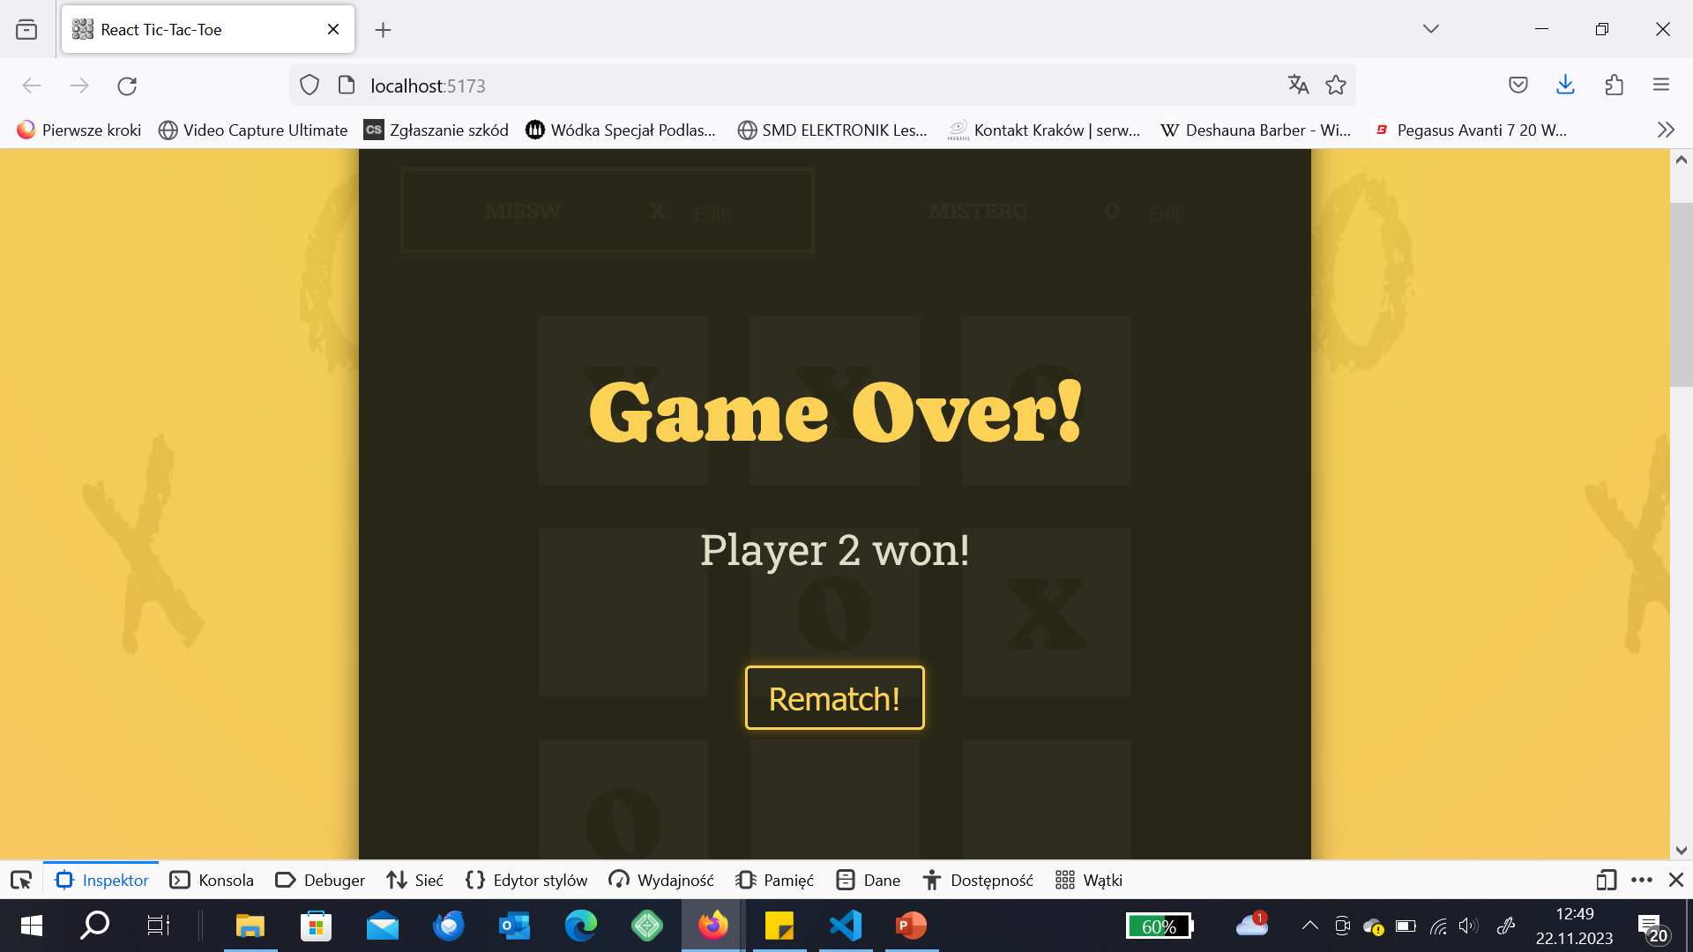

Slide 100
Cleaning up
Open Tic-Tac-Toe_step_11 – before changes
Tic-Tac-Toe_step_12 – after the changes

Slide 101
We will move parts of code outside of App function for clarity
function deriveWinner(gameBoard, players){
let winner;
for(const combination of WINNING_COMBINATIONS){
const firstSquareSymbol=gameBoard[combination[0].row][combination[0].column];
const secondSquareSymbol=gameBoard[combination[1].row][combination[1].column];
const thisSquareSymbol=gameBoard[combination[2].row][combination[2].column];
if(firstSquareSymbol && firstSquareSymbol===secondSquareSymbol && secondSquareSymbol===thisSquareSymbol){
winner = players[firstSquareSymbol];
}}
return winner
}

Slide 102
We will move parts of code outside of App function for clarity
function deriveGameBoard(gameTurns){
let gameBoard = [...initialGameBoard].map(array=>[...array]);
for (const turn of gameTurns){
const {square, player} = turn;
const {row, col} = square;
gameBoard[row][col] = player;
}
return gameBoard;
}

Slide 103
App.jsx
import Player from './Player';
import GameBoard from './GameBoard';
import './index.css';
import {useState} from 'react';
import Log from './Log.jsx';
import {WINNING_COMBINATIONS} from './WinningCombinations.js';
import GameOver from './GameOver.jsx';
const initialGameBoard = [ [null, null, null], [null, null, null], [null, null, null] ];
function deriveActivePlayer(gameTurns){
let currentPlayer = 'X';
if(gameTurns.length > 0 && gameTurns[0].player === 'X'){
currentPlayer = 'O’; }
return currentPlayer; }
function deriveWinner(gameBoard, players){
let winner;
for(const combination of WINNING_COMBINATIONS){
const firstSquareSymbol=gameBoard[combination[0].row][combination[0].column];
const secondSquareSymbol=gameBoard[combination[1].row][combination[1].column];
const thisSquareSymbol=gameBoard[combination[2].row][combination[2].column];
if(firstSquareSymbol && firstSquareSymbol===secondSquareSymbol && secondSquareSymbol===thisSquareSymbol){
winner = players[firstSquareSymbol]; }}
return winner }
function deriveGameBoard(gameTurns){
let gameBoard = [...initialGameBoard].map(array=>[...array]);
for (const turn of gameTurns){
const {square, player} = turn;
const {row, col} = square;
gameBoard[row][col] = player;
}
return gameBoard; }
export default function App() {
const [players, setPlayers] = useState({ X: 'Player 1’, O: 'Player 2’ });
const [gameTurns, setGameTurns] = useState([]);
const activePlayer = deriveActivePlayer(gameTurns);
const gameBoard = deriveGameBoard(gameTurns);
const winner = deriveWinner(gameBoard, players);
let hasDraw = (gameTurns.length === 9 && !winner);
function handleSelectedSquare(rowIndex, colIndex){
setGameTurns((prevTurns) => {
const currentPlayer = deriveActivePlayer(prevTurns);
const updatedTurns = [{square: {row:rowIndex, col:colIndex}, player:currentPlayer},...prevTurns];
return updatedTurns;
});
}
function handleRestart(){
setGameTurns([]); }
function handlePlayerNameChange(symbol, newName){
setPlayers(prevPlayers => {
return {
...prevPlayers,
[symbol]: newName
}; }); }
return (
<main>
<div id="game-container">
<ol id="players" className="highlight-player">
<Player initialName="MissW" symbol="X" isActive={activePlayer==='X'} onChangeName={handlePlayerNameChange}></Player>
<Player initialName="MisterQ" symbol = "O" isActive={activePlayer==='O'} onChangeName={handlePlayerNameChange}></Player>
</ol>
{(winner || hasDraw) && <GameOver winner = {winner} onRestart={handleRestart} />}
<GameBoard onSelectSquare={handleSelectedSquare}
board={gameBoard}>
</GameBoard>
</div>
<Log turns={gameTurns} />
</main>
)
}

Slide 104
